Slide 1

AdventureWorks Analytics Business Insights with Tableau
Prepared By: Sailaja Prasad Das
Date: April 17, 2025

Slide 2

Table of Contents
Introduction
Customer Analysis
Sales Analysis
Profit Analysis
Executive Summary
Conclusion

Slide 3
Introduction
Dataset Used: AdventureWorks (customer, product, territories)
Source:
Microsoft SQL Server 2022
Tool Used:
Tableau Desktop
Objective:
Derive actionable insights from AdventureWorks Database

Slide 4
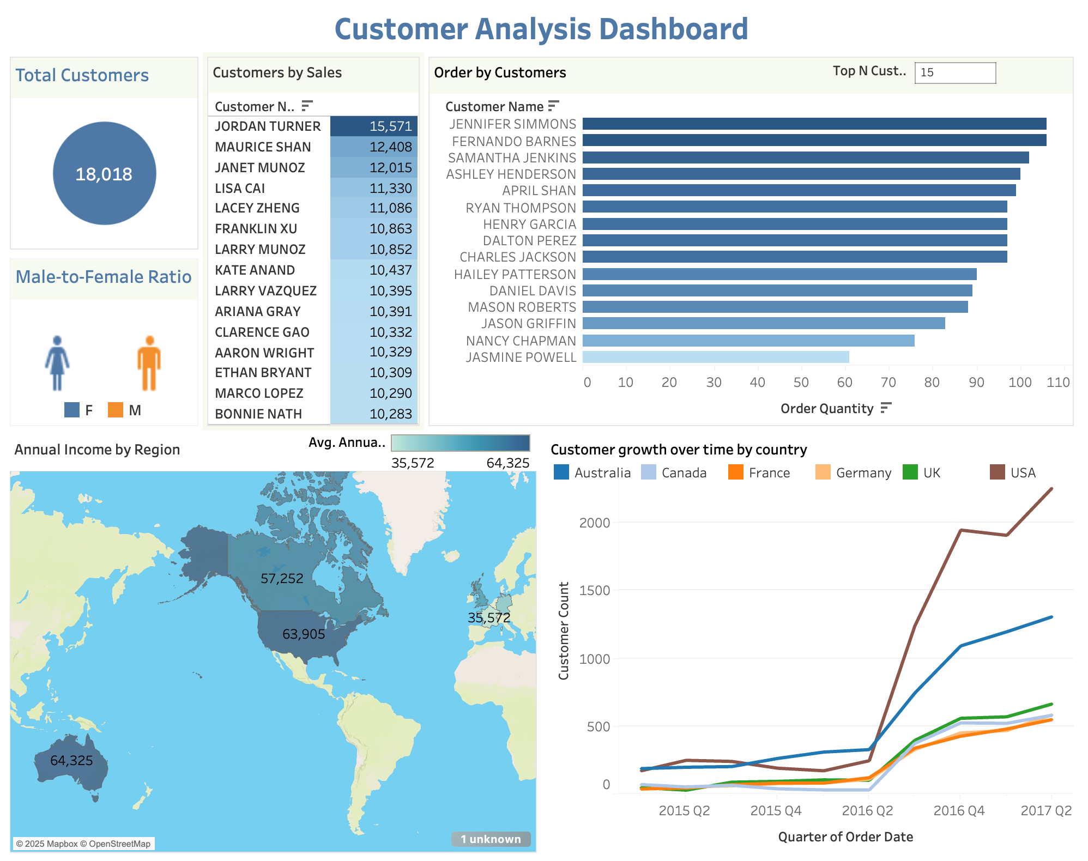
Customer Analysis
Total Customers: 18,018
Top Customers by Sales: Jordan Turner (15,571), Maurice Shan (12,408), Janet Munoz (12,015)
Top Customers by Order Quantity: Jennifer Simmons, Fernando Barnes, Samantha Jenkins
Gender Split: Higher male representation

Slide 5
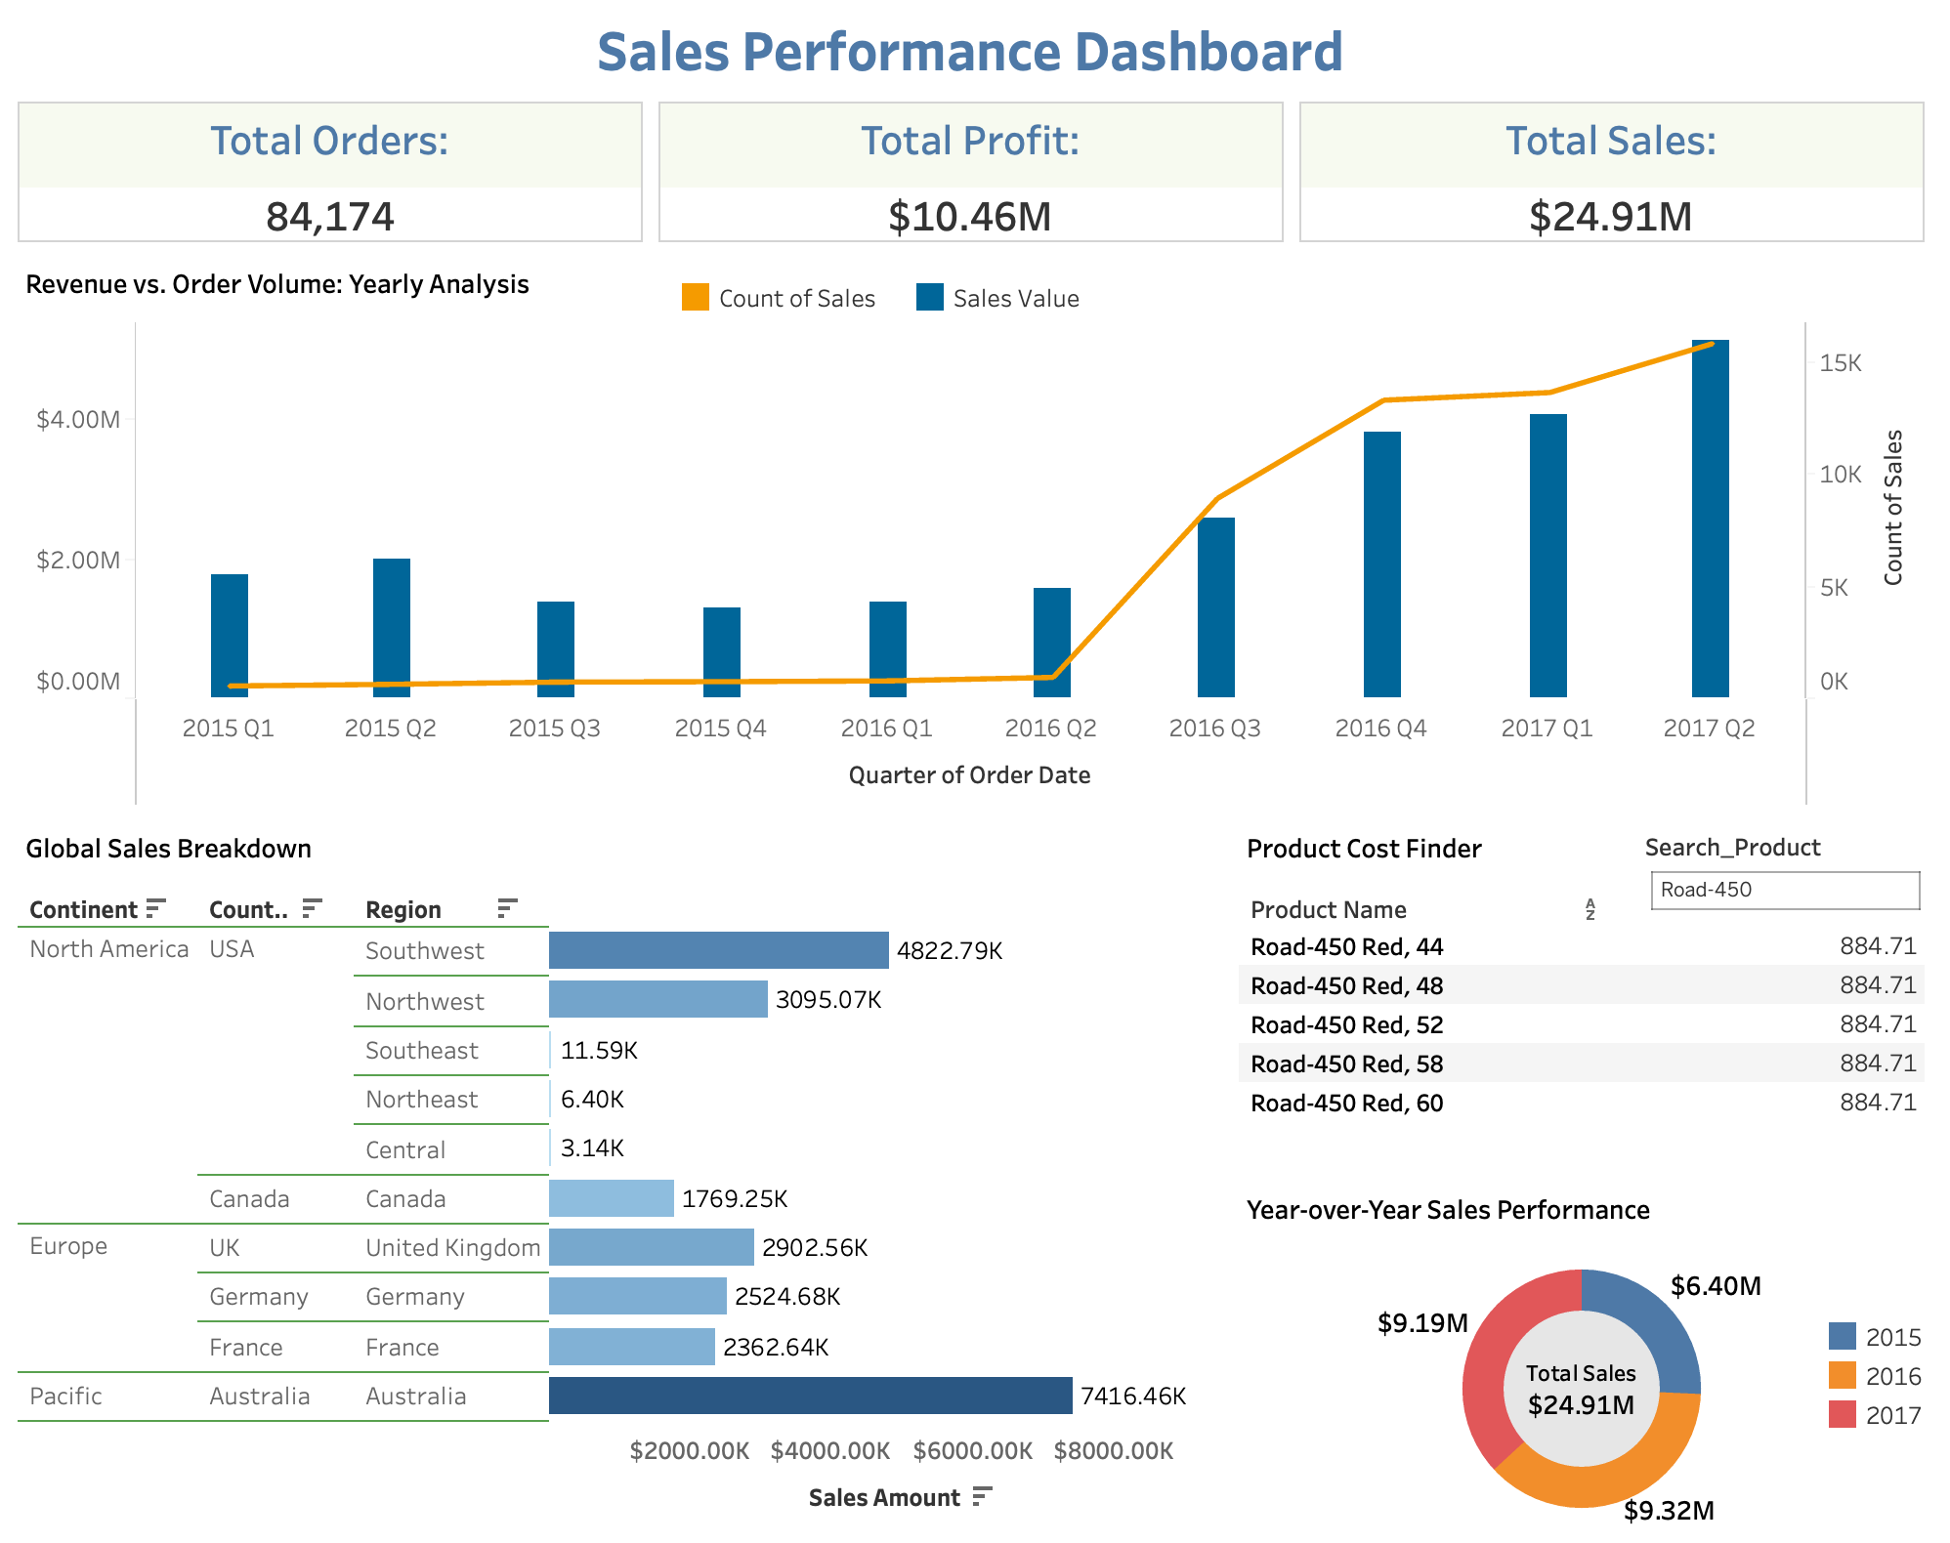
Sales Analysis
Total Orders: 84,174
Total Profit: $10.46M
Total Sales: $24.91M
Australia leads all regions with $7.42M in sales.
Europe shows consistent contribution led by UK and Germany.
Steady sales until 2016 Q2, then a sharp growth starting 2016 Q3.

Slide 6
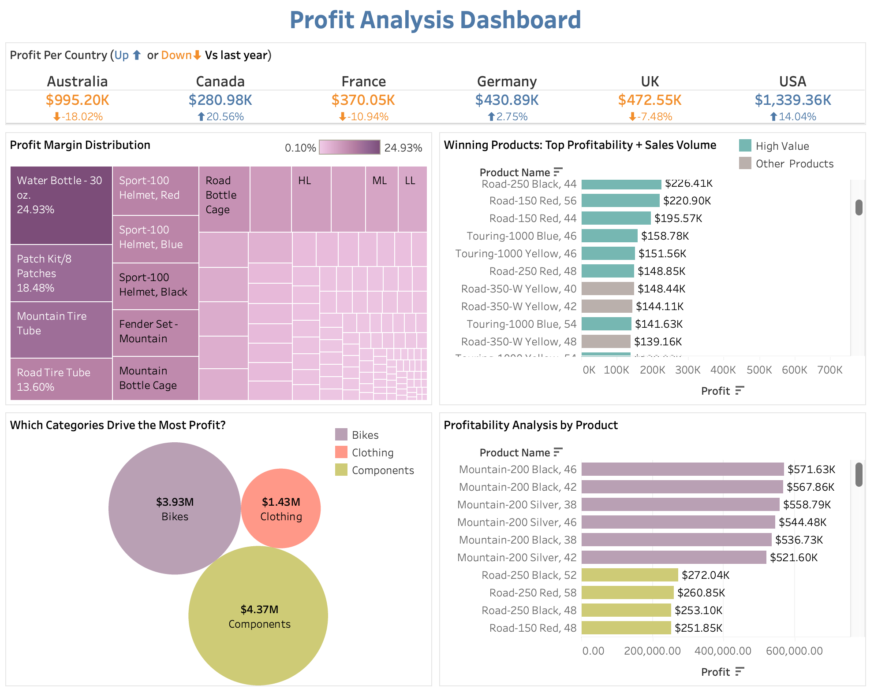
Profit Analysis
USA leads in profit with $1.33M, a 14% increase over last year.
Australia, despite high profit, saw an 18% decline YoY.
Top profitable product: Mountain-200 Black, 46 at $571K.
Components category generated the highest profit: $4.37M.
Water Bottle - 30 oz. had the highest margin (24.93%).
Germany and Canada showed positive growth despite smaller volumes.

Slide 7

Executive Summary
Sales and profits demonstrated steady growth, reaching their highest point in Q2 2016.
The United States (31.86%) and Australia (29.77%) are the leading contributors to total sales, underscoring their strategic importance.
Professionals emerge as the most engaged and profitable customer group, presenting opportunities for targeted retention and upsell strategies.
Germany and the UK are exhibiting increasing customer adoption, indicating strong potential for further expansion.
While product pricing is generally aligned with cost structures, certain categories require margin improvement to enhance overall profitability.

Slide 8

Conclusion
To summarize, these dashboards collectively provide a 360-degree view of customer engagement, regional sales performance, and profit centres.
By visualizing key metrics, we enable data-driven strategies that improve decision-making and performance.
Focusing on high-value products, growing markets, and profitable customer segments ensures sustainable business growth.

Slide 9

Thank you!

